Slide 1
How to manage School Transition Anxiety for Parent’s and Children Wednesday 17th July 9.30-10.30am
Jody Timms & Natalie McNamara

Slide 2
What will we cover?
Introduction to the counselling service
What is anxiety?
How to notice Anxiety in yourself and your child
Stress and ways to manage it
What Parent’s can do to help
Questions

Slide 3
Looking after ourselves
Housekeeping
Avoiding distractions
Respecting each others privacy
Valuing different experiences
All questions are welcome, there’s no such thing as a silly question
Fire alarm

Slide 4
Introduction
Jody & Natalie

Slide 5
What is Counselling?
A talking therapy which helps with life struggles.
Provides a safe place where your child can get things off their chest.
It can help to make sense of what is happening, resolve complicated feelings. And
Helps to find ways of coping when things are difficult.
Can empower you and encourage growth.

Slide 6
What we can help with?
We can support student’s with:
Anxiety / Low mood
Stress
Self esteem / confidence
Grief/loss
Relationships (with friends, family and others)
Bullying
Amongst other issues which may not be listed
To access this service speak to your children’s head of year.

Slide 7
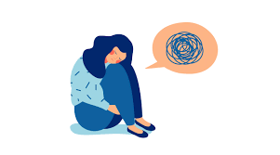
What is Anxiety?
Occasional Anxiety is a normal response which presents when we feel we are in danger/stressed.
`
Everyone experiences
Anxiety at some point.
Anxiety can become overpowering and impact lives in a negative way when it lasts for long periods of time.
Anxiety often causes physical symptoms such as racing heartbeat, stomach ache etc
Being anxious can feel difficult, lonely and isolating
Many people recover from anxiety disorders with support and awareness

Slide 8
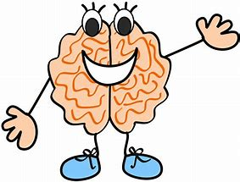
Slide 3
Why Do We Need Anxiety?
Anxiety alerts a bodily alarm system that warns us when we are in danger. For example; If there was a fire or if someone was going to hurt us.
Anxiety keeps us safe and alive, it helps us to remain cautious, organised and can help us to perform well.
Anxiety can help us to perform well under pressure.

Slide 9
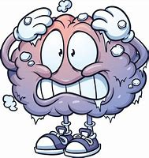
When Does Anxiety Become Unhelpful?
When the anxiety alarm is going off and there is no danger.
It can encourage overthinking.
When you stop doing things you enjoy
When we experience ongoing physical symptoms
When we give it too much POWER!

Slide 10
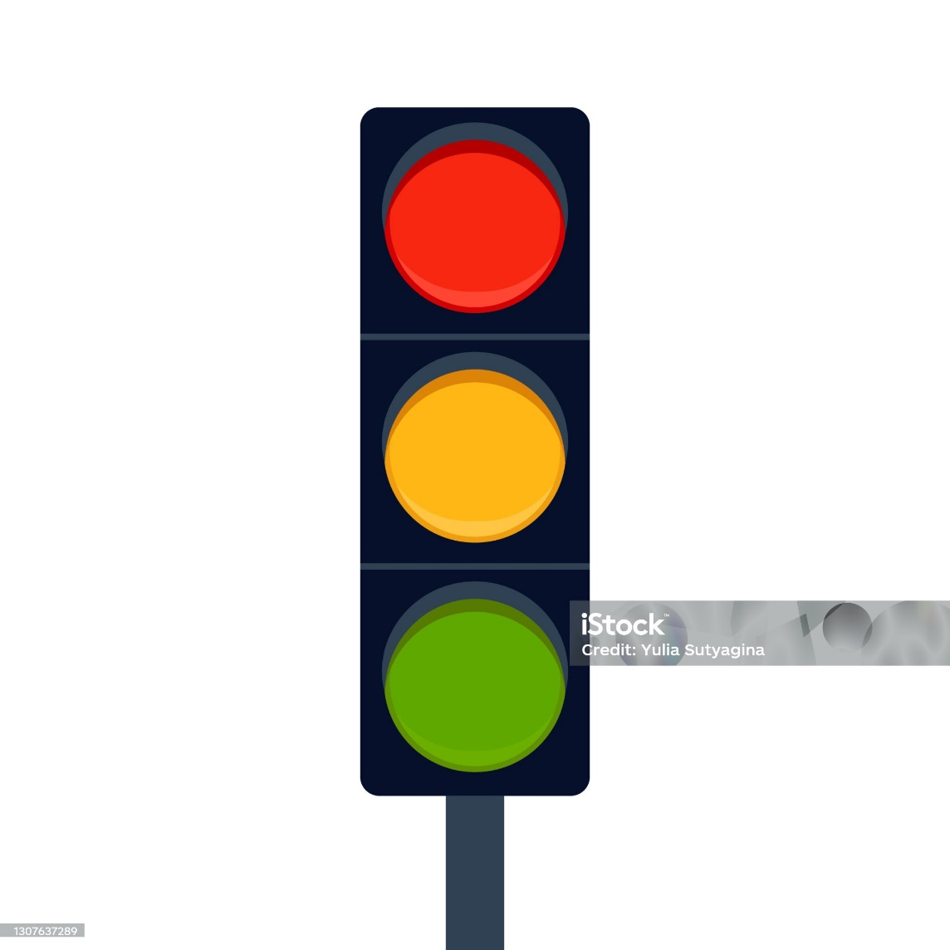
Traffic light bodily response
Green Zone (Socially engaged)
Safe, connected, relaxed, playful, good, okay, engaged.
Amber Zone (Fight or flight)
Nervous, on edge, hot, panicked, tense,
distressed, shaky
Red Zone (Freeze)
Low, lost, shut down, blank, cold, no energy

Slide 11
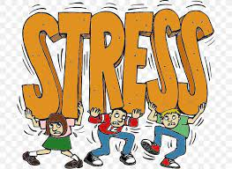
Understanding Stress
Stress has a lot of the same symptoms as anxiety. Stress doesn’t last as long as anxiety, its usually temporary and triggered by an event such as exams or the school transition.
Anxiety is persistent and when the worries don’t tend to go away, stress can lead to anxiety. Symptoms include
Not sleeping well
Low mood or negativity
Feeling hopeless about the future
Nail biting, skin picking, hair pulling, teeth grinding
Tears and tantrums
Sleeping or eating more/less than normal

Slide 12
The Basics
Recognise that as a parent you too will be feeling the transition stress/anxiety.
Acknowledge how you are feeling.
Talk about your feelings this can help your child to open up.
Sleep, eat, drink, exercise.
Encourage time for fun and relaxation.
What do you both need?

Slide 13
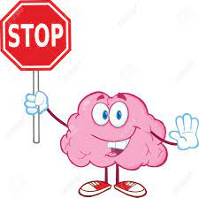
Stop..…
Bottling up feelings.
Trying to control the uncontrollable.
Avoiding doing the uncomfortable.
Putting yourself/your child down.
Comparing yourself/your child to others.

Slide 14
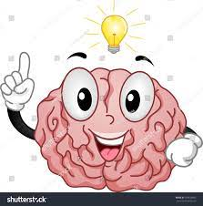
Start…
Becoming comfortable with the uncomfortable.
Recognising what you can/cannot control.
Listening without judging or interrupting.
Supporting yourself/your child by using the tools discussed.
Access help and support.
Give praise.
Reiterate that you are there to help and are doing your best.

Slide 15
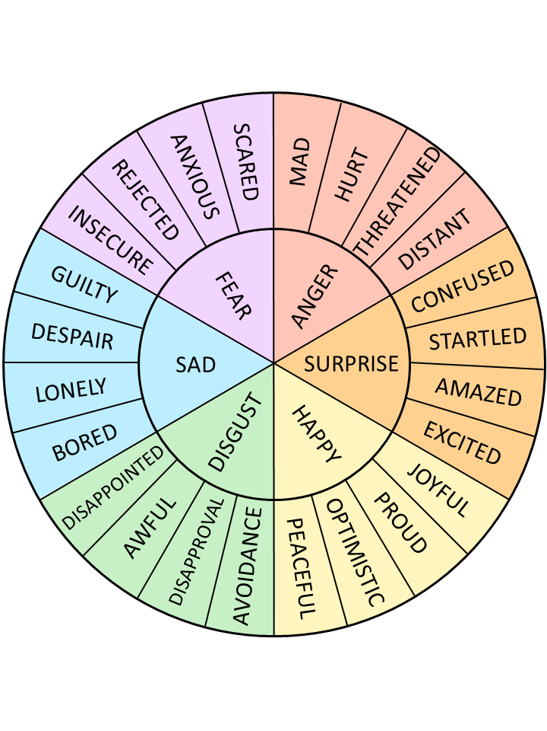
The Feelings Wheel
The feelings wheel helps us to identify our feelings and put a name to them

Slide 16
Challenge your thoughts.
Thoughts are not facts.
Can you look at things differently?

Slide 17
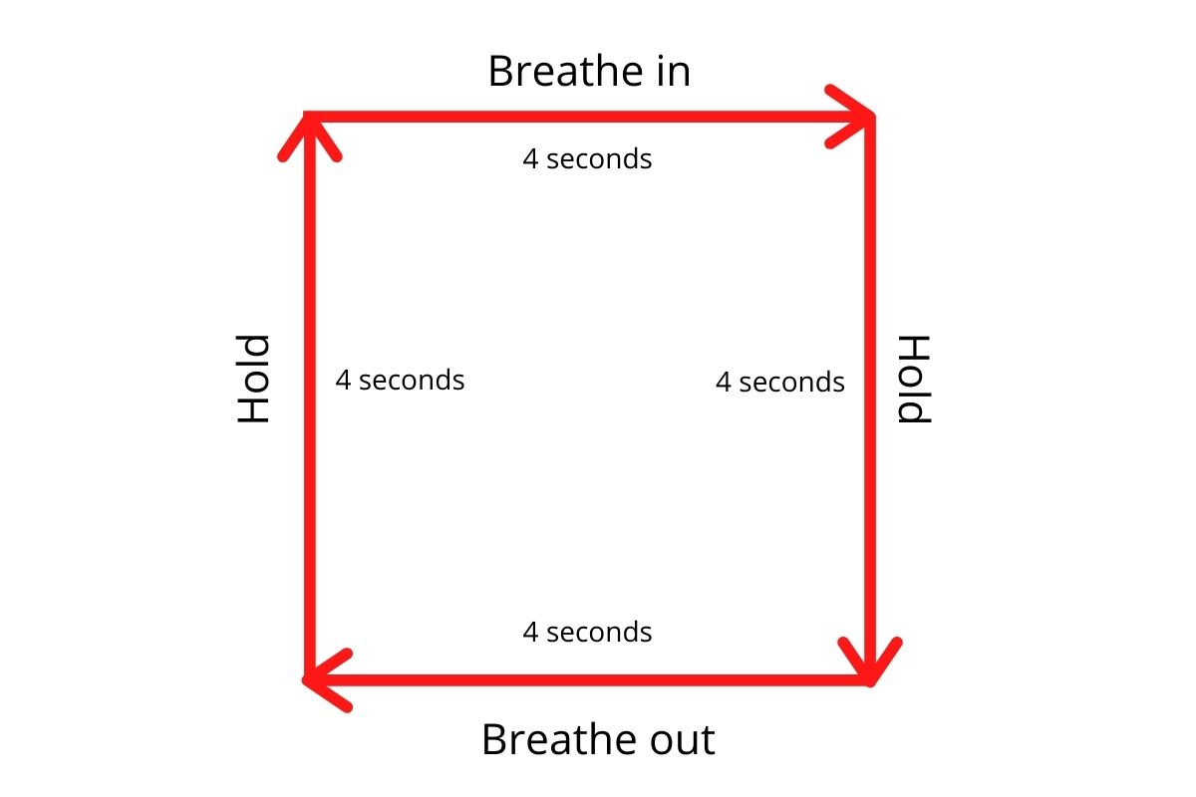
Box breathing is a great way to reduce anxiety. Breathing techniques work because they calm the nervous system

Slide 18
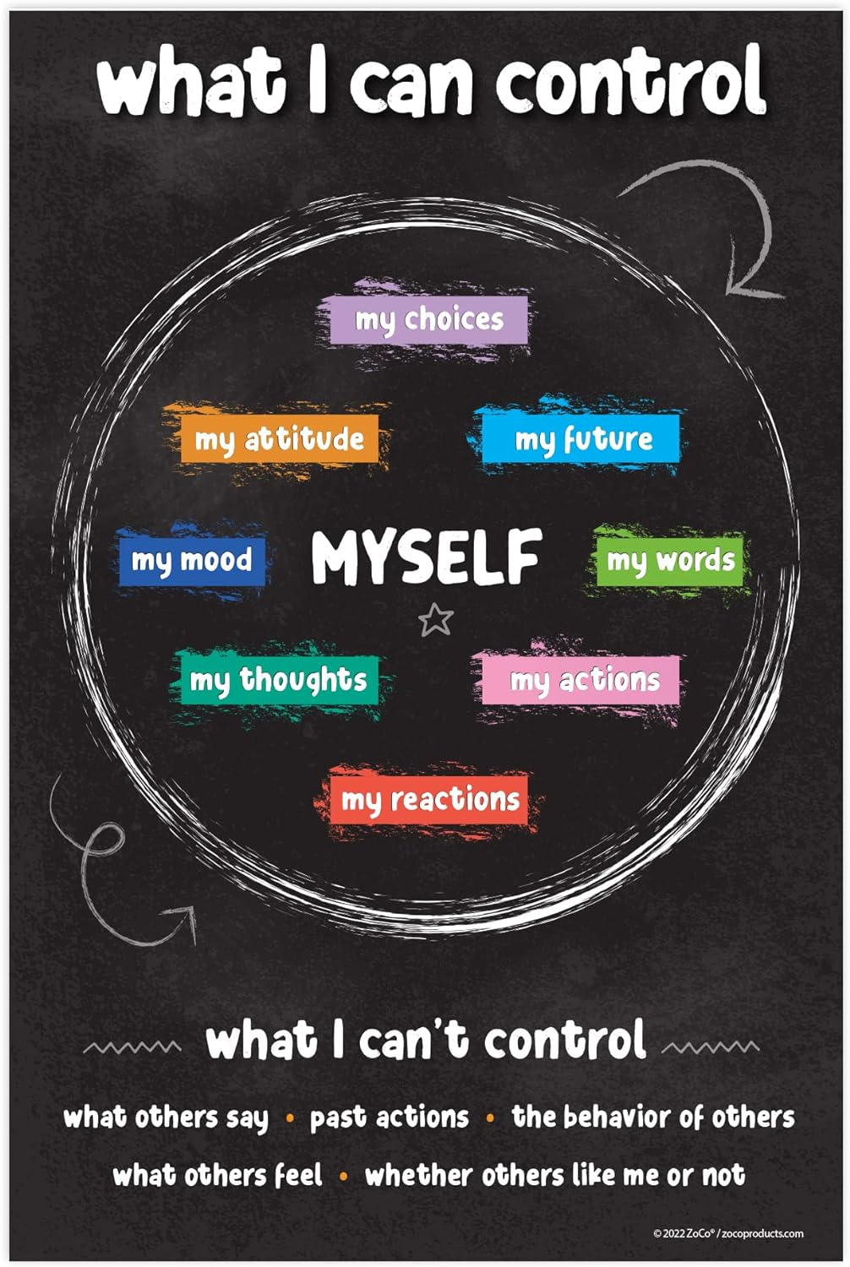
Making yourself aware of what you can and can’t control can help with managing your thoughts.

Slide 19
Signposting
GP
Young Minds (Parent Helpline)
NSPCC website
Childline 0800 1111
Shout Free Text Counselling service 85258 (Anyone, any age)

