Slide 1
Reporting Systems
SALE

Slide 2
Purpose
‘We believe from the moment a student starts Sale High School that they should have aspirational dreams, goals and targets. When students, parents and schools work together a child can flourish.’

Slide 3
What do we want to achieve?
To acquire, develop and master skills and knowledge that are required for success in their subjects.
To incorporates summative assessment which supports continual formative feedback.
Allows the pupil to reflect on their learning and revisit if required.
Allows parents to support their child’s learning.
Clearly show when students are on/not on track so swift and effective intervention can take place whatever their year group.

Slide 4
Assessment over a half term
One piece (two for KS4) of work will be marked every half term and detailed feedback given by the teachers on what you did well and what you need to do to improve.
Work will also be self or peer assessed
One assessment per half term based
Success criteria and PLCs are used to support students in next steps.

Slide 5
Reporting to parents
Assessment reports will be available 2x a year for KS3 and 3x a year for KS4.
Assessment reports contain information to let you know if your child is making progress, attitude to learning and homework for each subject.
There will be a Winter and Summer exam series each year and we will report % for each subject at KS3 and grades at KS4.
Year 11 will have an additional set of exams in March.
Once a year parents evening
Parent Information evenings will support in the preparation for exams

Slide 6
KS3 report layout
Progress:
Students are initially ranked using the average of their KS2 scores in reading and maths and assigned a quintile, so the year group is divided into 5 groups.
After each exam series (summer and winter) students are ranked and re-assigned a quintile based on their new results.
Students should aim to maintain or surpass their previous quintile and make overall progress from their starting quintile.
Homework: This is reported as excellent, good, satisfactory, variable and poor. Excellent is reserved for homework that is always time, high performance, excellent presentation, excellent effort and completed to the best of their ability
Attitude to Learning: This is reported as motivated, active, passive, disengaged. A motivated student is an independent learner who is driven and highly aspirational.

Slide 7
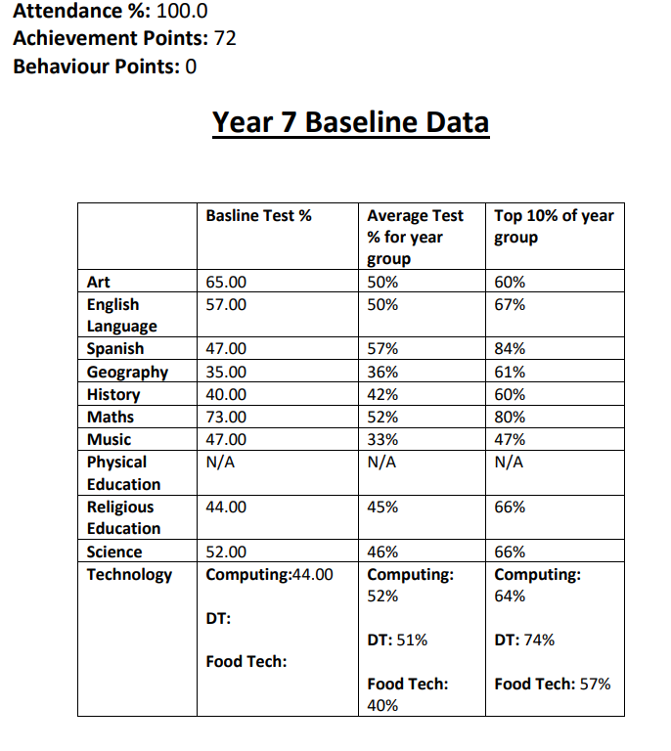
This report is accessed through the SIMs app The report is designed to give parents and students an idea of how they are doing in their year group It provides teachers information on prior subject knowledge and what needs to be retaught It will provide information of which subjects they are doing well in and which subjects they maybe struggling in and need a greater focus on at home. Revision guides are available for core subjects through the library and purchased via parent pay or bbc bitesize can support learning

Slide 8
GCSE Grades
The grade 4 will be achieved by the same proportion of pupils who currently attain a grade C or higher. This is known as the standard pass.
A grade 5 has been set as a GOOD PASS and is intended to act as a benchmark against international standards.
A grade 7 should be set such that the proportion achieving grades 7, 8 or 9 should be the same as those who were awarded A or A*.

Slide 9
KS4 Report Layout
Target: This is based on prior attainment from KS2 results in reading and maths and goes from Grades 1- 9 (9 being the highest). These targets are ambitious and can change according to performance.
Homework: This is reported as excellent, good, satisfactory, variable and poor. Excellent is reserved for homework that is always time, high performance, excellent presentation, excellent effort and completed to the best of their ability.
Attitude to Learning: This is reported as motivated, active, passive, disengaged. A motivated student is an independent learner who is driven and highly aspirational.
Working at Grade: This grade is how they are performing at this time and is based on GCSE grades 1-9 (9 being the highest). A ‘+’ means that they are secure in that grade and have potential to get the next grade. A ‘–’ means that they are less secure in that grade and are close to the lower boundary.
Prediction: This grade is a teachers professional prediction for what they believe the child to receive in their GCSE.

