Slide 1
Sale High School Revision Guide
How to prepare for exams, tests and assessments

Slide 2
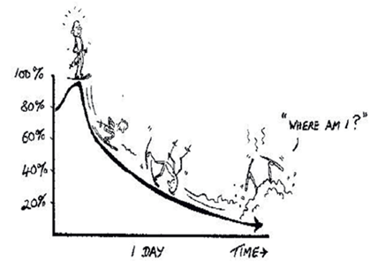
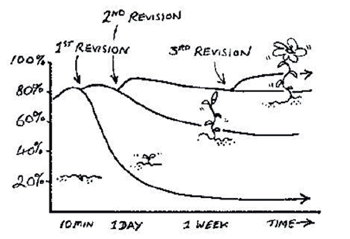
The statistics about revision
After studying a topic the average person forgets
66% of material after 7 days
88% of material after 6 weeks
Reading notes and text books leads to a mere 10% retention. Do NOT revise by just reading.
To remember information the information that you need for your exam you must review it and review it. It will then stick better.
Spaced learning and review
After each hour revising a topic you need to review at least 4 more times to make it stick.
10 minutes later revise the topic for 10 minutes
1 day later revise the topic for 5 minutes
1 week later revise the topic for 2-5 minutes
1 month later revise the topic for 2-5 minutes
Before exams revise the topic as required.
Each time knowledge is reinforced; it enters deeper into the long-term memory and becomes more stable.
This diagram shows that if we only go over a topic once we forget almost all of it very quickly. We call this the ‘slide of doom!’
This graph shows that if we review topics on at least four occasions and at key times we strengthen the neural connections in our brain and so stop the ‘slide of doom.’
Key Points:
The average person will need to revise each topic at least FOUR times
Revise in different ways which involve actively doing something with the information rather than just reading it.

Slide 3
Getting it right
Relax – if you are tired, stressed, upset or anxious you will find it more difficult to absorb and memorise information. This is one reason why leaving revision until the last minute and ‘cramming’ does not work.
Think positively. Dare to believe in yourself. Don’t tell yourself ‘I won’t be able to do this’ but rather say to yourself ‘This will be challenging but I will be able to do it.’ As the saying goes ‘If you think you can or you think you can’t, either way you are probably right.’ Neuroscience tells us that when we say ‘I’ll never be able to get this right’ our brain lights up brain cells that are connected to failure and so we fail. However, we also know that when we think more positively different brain cells light up: ones that make us more alert and help us to find the information that we need. So, think you can and never, ever give up.
Link information together – Our brains find it easier to memorise information once it is linked into a story or a logical progression of ideas. If you are able to find the logical progression of ideas – story – you will find it easier to remember and each step of the story will trigger the next part.
Think creatively - We usually find it easier to remember images, movement, physical sensations, colour, rhythm, rhyme and feelings more easily than words and sentences. Try to picture the people, events, objects or whatever to make them more real in your mind. The more that you use imagination and creativity in your revision, the stronger links you will build between your brain cells, and your memory will become better.
Review - Reviewing your work again and again is the key to a successful memory. You must review you work enough times on enough separate occasions.
Steps to success
Prepare – check your understanding of the information. Use your revision list to help you identify and fill any gaps in your notes and knowledge
Condense the information that you need to memorise. The techniques in this guide will help you to do this.
Memorise the information that you need for the exam. The techniques in this guide will help you to do this more quickly and efficiently.
Practise using what you have memorised to complete past papers
Compare - read model answers and answers written by people who got more marks than you
Steal - copy the techniques used in the model answers

Slide 4
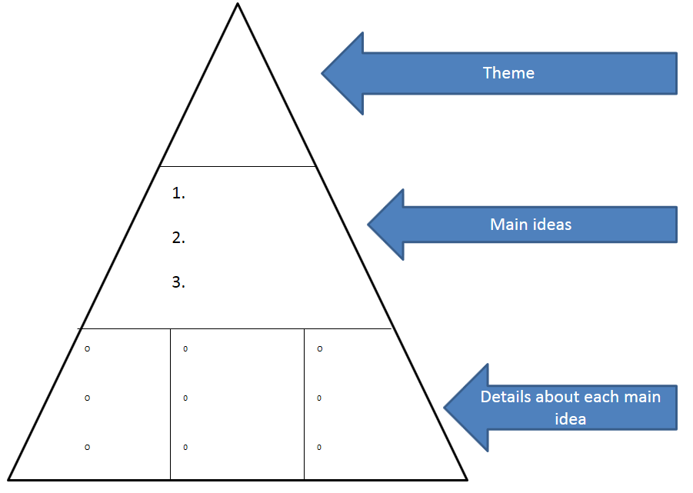
Revision Techniques
Preparation
Identify the gaps in your knowledge. Read over your revision list and identify any topics that you missed or found challenging. Prioritise these and find them in your revision guide. Do this early so you can ask your teacher for help with it if needed. Keep repeating this process after every few revision sessions.
Read over your exercise book and underline any information that you hadn’t remembered in green. Read over your book again and highlight any you still found difficult to remember in red. Repeat this exercise and highlight in yellow, then green, then red etc etc. You should find that you are highlighting and having to focus on less and less each time as you memorise more and more. However, when you do this you must be careful to check where you have missed topics and when yo have done a piece of work that did not get you a top grade.
Condensing information – this is powerful because you really have to think about what you are reading to do it. You have to work out what is the most important information that you will need, what detail is important and what you can leave out. Only about 20% of any text is about the ideas and concepts that we must remember and about 80% of the words are just there to help it make sense. We cannot and do not need to remember every word of a piece of text. We just need to remember the ideas and concepts and that is how the brain remembers information more effectively. This means that we have a great opportunity to make revision much quicker and more effective by cutting out as many of the words from the 80% as possible. This is called condensing.
Condensing Step 1 - It can be easier to find the ‘main ideas’ if you remember that the main idea is usually what a paragraph, section or chapter is about. Look for words that get repeated a lot and check the first and/or last sentence to see if they sum it up for you. Try writing a short headline or sub heading for each paragraph/section. The details are information that supports or are about the main idea.
Condensing Step 2 – ‘Details’ will answer the who, what when, where why, how questions about the main idea. You can present your condensed information as a list, notes or a diagram according to what you prefer.
Memorise
Make your own quiz – drawn vertical a line down the middle of your page. Write a long series of questions about each topic down the left hand side and write the answers down the right hand side. Try to phrase the questions so the answers are brief. Cover the answers and test yourself several times. Underline the ones that you still need to improve on. Repeat and underline the ones that you still need to work on in a different colour. Repeat and highlight in yellow. Repeat and highlight in green etc etc. Now cover up the questions and see if you can guess the questions from looking at the answers. Now get a friend or relative to test you on them.

Slide 5
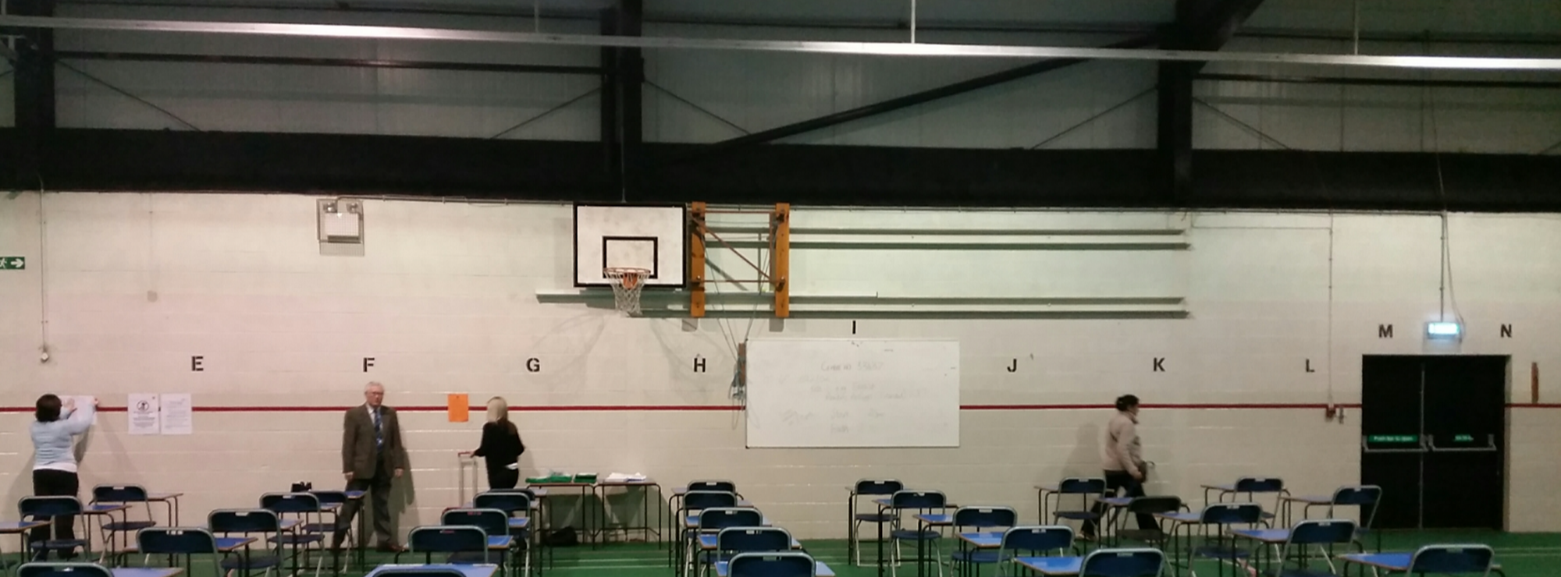
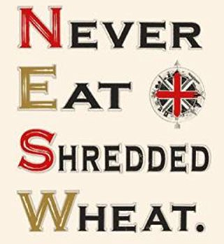
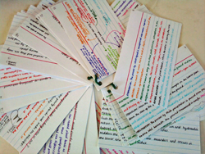
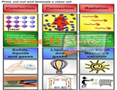
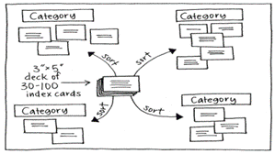
Revision Techniques
Memorise
Loci – think of a series of locations that are very familiar to you (e.g. places around your house, your journey to school or even the front of the exam hall!) and imagine items that represent what you have to remember being located at each spot. This method is brilliant and is popular with Derren Brown, memory champions and even the ancient Romans!
Peg words – Peg words link each item that you need to remember to a visual image based on a number rhyme. This is very simple when you get used to it and is highly effective for memorising lists of up to 10 items. The number rhymes are 1 = sun, 2 = shoe, 3 = tree, 4 = door, 5 = hive, 6 = sticks, 7 = heaven, 8 = gate, 9 = wine and 10 = hen. So you might imagine your first item on top of the sun, your second sticking out of a shoe, your third hanging from a tree and so on.
Image chains – good for memorising a list of words. Just take each item on the list and link them together using a story. The sillier and funnier the story the more memorable it is likely to be!
Mnemonics – there are lots of existing mnemonics that you can use but you can also make up your own. For example, you can write a list of key phrases that you must remember and highlight the first letter in each. Now create a memorable memory sentence in which each word starts with one of the letters highlighted.
Read-Cover-Recall-Check
Read the information you want to remember. Cover it up, write out what you remember. Check to see how much you forgot.
Use it to test yourself on; Spellings, Lists, A sequence of events
Flashcards and revision cards
For key information and facts. Write a heading or a question at the top and then the key points or answers below or put the heading/question on one side of the card and the key points/answers on the other. You can carry them around with you and test yourself anywhere.
Make a card sort
Make a set of cards that you can cut out, mix up and match.
Use them; When you need to remember pieces of information that go together.
Memorise
Key word cards
Include definitions on the back. You can test yourself on the definitions, sort them into categories, put them into a sequence.
.

Slide 6
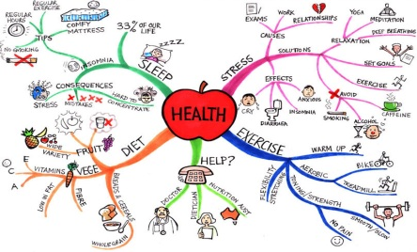
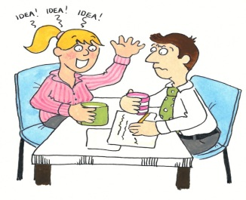
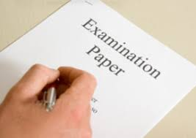
Revision Techniques
Memorise
Mind maps
Start with a central theme and organise the information from it, grouped into subtopics. Label the branches with the relationships.
To summarise a whole topic after revising it in detail. Only put in the key words, everything else should come to mind when you read it.
Argument maps
Plan a model answer for an expected question by using an argument map. They can be used to help you organise relevant information to tackle a range of questions including making comparisons, showing two sides of an argument and explaining a process. Many ready made templates are available free online.
Describe or explain an event/ argument/process/scenario to someone who does not know it or a classmate.
They can ask questions to fill in any gaps you missed and if they are also revising it may help them understand the work better.
Use it when; Explaining a series of events or a process that has some detail
Online resources
You will notice that most of these revision techniques do not require the use of a computer. That is deliberate. For most students having access to their phone or a computer is a massive distraction that is best avoided (it is usually best for parents and carers to ‘look after’ their child’s phone while they are revising!). However, there are some good resources online including BBC Bitesize and MyMaths.
Past exam questions and analysis
Imagine sitting down to an exam to find that you have answered all the questions before! Imagine how easy that would make the exam! That is what we are working towards here. Research shows that the highest performing students complete the memorising stage of revision early enough to be able to spend the majority of their time writing model answers to exam questions. Complete some past exam questions. Mark your answers. Fill in the answers you missed. Go through the paper and colour code each topic (Red-need to revise, Amber-Need to go over a few bits again, Green-I’ve got it). Ask your teacher to mark your work and see them smile with admiration! You can usually get past GCSE papers from your teacher or from the exam board website.
Use it to test your ability to; recall the information you have revised, to answer the question asked, not just write down everything you know, to follow the command words in an exam, to work in timed conditions and to structure your answers so that you get maximum marks out of the knowledge that you have .
Practise

